Slide 1
Test Driven Development
Test First Development in .NET

Slide 2

In This Module
What is it?
What will it do for me?

Slide 3
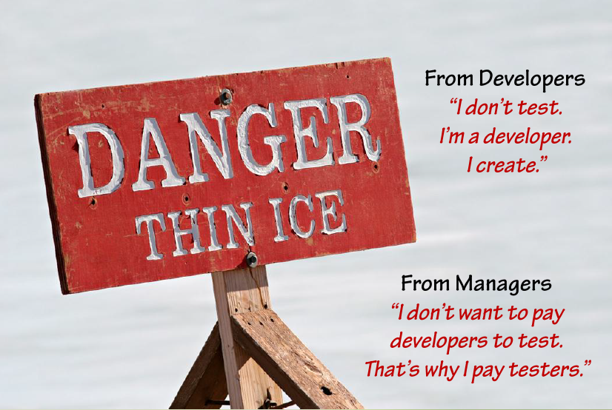

Slide 4
Unit Tests
Test a small but functional piece of code
public ActionResult Login(LoginModel model, string returnUrl)
{
// …
}

Slide 5

It’s Something You’ve Already Done
Ever run in the debugger after the code compiles?
Unit test framework
Adds structure
Repeatability

Slide 6


Slide 7
The Economics of Developer Testing
Realizing quality improvement through test driven development
http://research.microsoft.com/en-us/groups/ese/nagappan_tdd.pdf
40% – 90% decrease in defect density
15% - 35% increase in development time
The cost of a released defect
is usually far more than the cost of preventing it

Slide 8
Cost of Fixing a Defect
Avoiding defects costs
much less than fixing them
Cost
Requirements
Coding
Integration
Beta Test
Post-Release

Slide 9
Leap Years
Microsoft Azure (2012) customers
TomTom GPS failure (2012)
PS3 network outage (2010)
Scientific Atlanta (2004)
Pontiac Grand Prix (2004)
Norwegian State Railways (2000)
Tiwai Pt Aluminum Smelter (1997)

Slide 10
Stairway To Heaven
Speed
Agility
Feedback
Continuous
Deployment
Continuous
Integration
Test Driven
Development
Traditional
Development

Slide 11
Extreme Continuous Deployment
Amazon deploys functionality every 11.6 seconds
90% reduction in outage minutes
0.0001% of deployments create an outage
http://code.flickr.com/
http://www.etsy.com/

Slide 13

TDD Makes Your Life Easier
Easier to find bugs in software
Easier to maintain and change software
Easier to understand code
Easier to develop new features

Slide 14
Thinking Like A Scientist
Hypothesis
Repeatable experiments
Conclusions

Slide 15
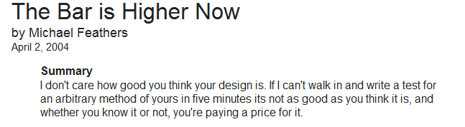

Slide 16

TDD Isn’t All About Testing
Confidence
Confidence in the code
Confidence to change the code

Slide 17
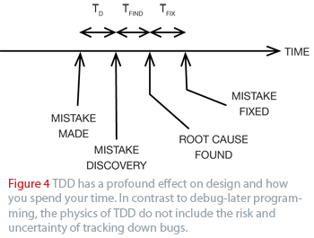
Less Time Debugging
TDD for Embedded C

Slide 18
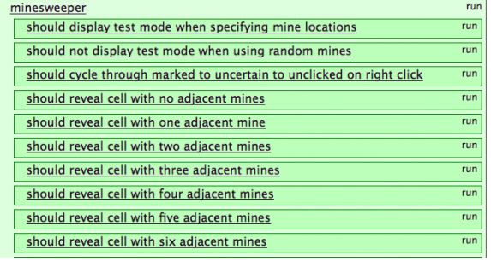
Creating Documentation With Teeth

Slide 19
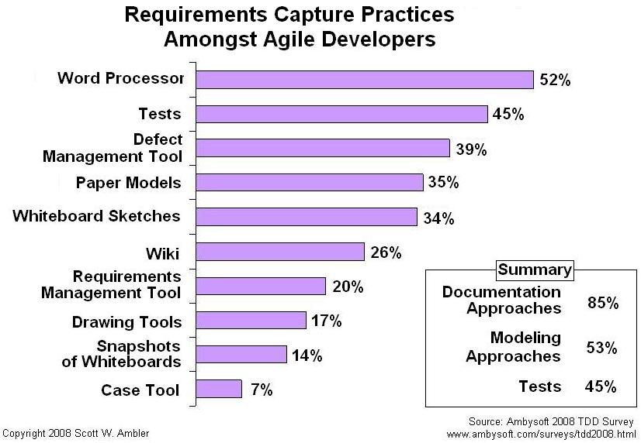
Capturing Requirements (Ambler 2008)

Slide 20
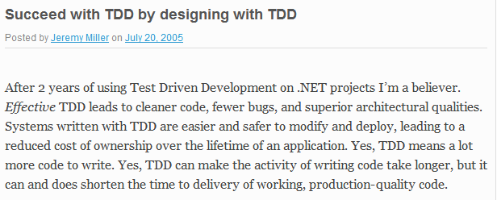
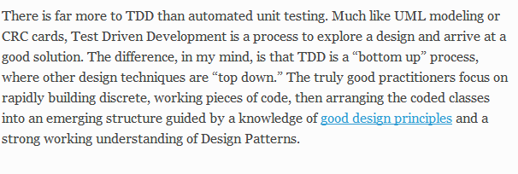
TDD Is About Design

Slide 21
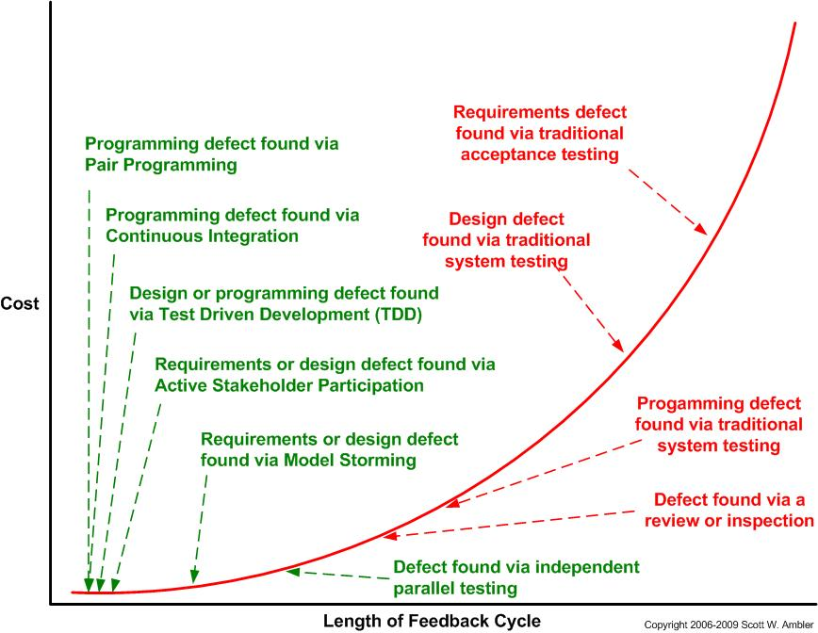

Slide 22
Testing Spectrum
Unit testing
Testing an isolatable ‘unit’ of code, usually a class
Integration testing
Testing a module of code (e.g. a package)
Application testing
Testing the code as the user would see it (black box)

Slide 23
Unit Testing
Programmer tests of individual units of code are fit for use
A unit is a small testable part of an application
Ideally, each test is independent
Done in almost all programming languages
Can be done with or without a unit testing framework

Slide 24
Testing a Unit
Unit vs. Integration Test
Unit Test Frameworks can be used to create
Unit Tests
Integration Tests
An app to exercise your app
Object 1
Object 2
Object 3
Method A
Method B
Method C

Slide 25
Unit Testing Frameworks
Usually consists of:
A software library included by your test library
A runner application that invokes tests in your library
Available for almost any language or runtime
For .NET
MS Test
NUnit
MbUnit
Many others
Unit Test Runner
Application
MyUnitTests
Library
System
Under
Test
Unit Test
Library

Slide 26
xUnit Architecture
Test Suite
Test Fixture
Test Case
Text Fixture
Test Case
Test Case
Test Case
Assertion
Assertion
Assertion
Assertion
Assertion

Slide 27
MSTest Implements xUnit Architecture
Test Suite
Test Fixture
.NET Class
Test Case
Method
Assert.AreEqual(0,1);
Assertion
Namespaces or Visual Studio Projects
xUnit Architecture
NUnit Implementation

Slide 28
Test-Driven
TDD helps you pay attention to the right issues at the right time so you can make your designs cleaner, you can refine your designs as you learn.
- Kent Beck

Slide 29
Test-Driven Development
Creating tests before
creating functionality
in the SUT
Create a new test
Run the test to see it fail
Make the test pass By adding functionality to the SUT
Refactor while keeping tests passing
Clean as we cook
Repeat

Slide 30
The Mantra
Red
Green
Refactor

Slide 31
The Result of TDD
Keep our SUT working at all times
Drive out design as it is needed
Ensure I didn’t just break something
Create a regression harness as a by-product
Reduced defect density
Typically creates more flexible, modular, and extensible code

Slide 32
Refactoring
From This
Changing the internal implementation of code without changing its external behavior.
public int ConstantMult(int y)
{
int x;
x = 3;
int p = x*y;
return p;
}
To This
public int MultiplyByFixedRate(int numberToMultiply)
{
return numberToMultiply * 3;
}

Slide 33
Common Refactorings
Rename
Extract Super Class
Pull Up Member
Extract Interface
Introduce Field

Slide 34
We Need Good Refactoring Tools
Or we won’t do it
Because its too hard
And we must
To improve our design
For code to be readable and maintainable
To express our intent

Slide 35
Summary
Writing Unit Tests
Unit Testing Frameworks
Anatomy of a Test Fixture
Test-Driven
Basic Refactorings

